Slide 1
Pay and Personnel Center
CAPT Derek Smith
Commanding Officer

Slide 2
Pay and Personnel Center
Retired and Annuitant Services
Automated Error Worksheets
RAS Optimization

Slide 3
PPC/RAS By the Numbers
35 RAS staff members serve:
55,837 Retirees
7,566 Annuitants
4,119 Former Spouses (FSPA)
(Numbers include USCG, NOAA, and USPHS)

Slide 4
VA COMPENSATION AND AUDIT ERROR WORKSHEETS (AEWs)
Updates:
The two year backlog is gone
Approximately 6000 backlog in 2020
Zero backlog in 2022
The temporary VA Compensation Team is gone
Still able to maintain 120 turnaround max
Average is 75 days

Slide 5
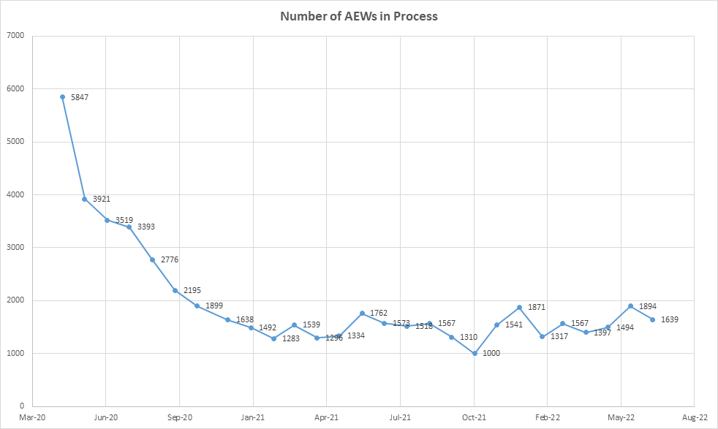
BACKLOG
NO BACKLOG

Slide 6
VA COMPENSATION AND AUDIT ERROR WORKSHEETS (AEWs)
Changes to Direct Access submitted to reduce manual input
Functional Requirements Document is one of my highest priorities
Inserts VA Comp database into Direct Access
Expected to result in 65% fewer touchpoints
Will greatly reduce turnaround time
Anticipate completion within the next six to twelve months

Slide 7
RAS Optimization
Study began late 2021
VA Compensation process
New Accessions (RET-2 to RET-1)
Deceased Claims
Decision memo signed April 2022
Over 30 findings

Slide 8
RAS Optimization
Significant findings
Create a Customer Response Team to improve outreach
Increase the personnel in VA Compensation & Deceased Claims
Increase automation in VA Comp
Add automation to the RET-2 to RET-1 process
Streamline the deceased claims process
Increase self-service options

Slide 9
Deceased Claims
Added two additional personnel (military)
June 2022 eliminated direct calls to Military Pay Techs
Established electronic case work
Impact:
In June 2022 average case load was 180 per tech
In Sep 2022 average case load is 70 per tech
Volume has not decreased
Efficiencies have increased

Slide 10
Customer Response Team (CRT)
Created to increase interaction with customers
Reduces the need for repeat calls
Sequence:
Tier 1 request are handled by PPC Call Center
Tier 2 requests go to Customer Response Team to solve or manage expectations
Tracked through case management software
Call back requests go to CRT
All correspondence is scanned and attached to ticket by CRT
Developing metrics

Slide 11
RET-2 to RET-1
Case management software now used to track RET-2 to RET-1
Increases inter-branch collaboration and communication
Increased communication with customers to confirm receipt of critical documents like DD 2656

Slide 12
Case Management Software (Ivanti)
RAS has converted to Ivanti to track customer tickets
Eliminates the need to print cases on paper
Easier to track
Improves communication between branches

Slide 13
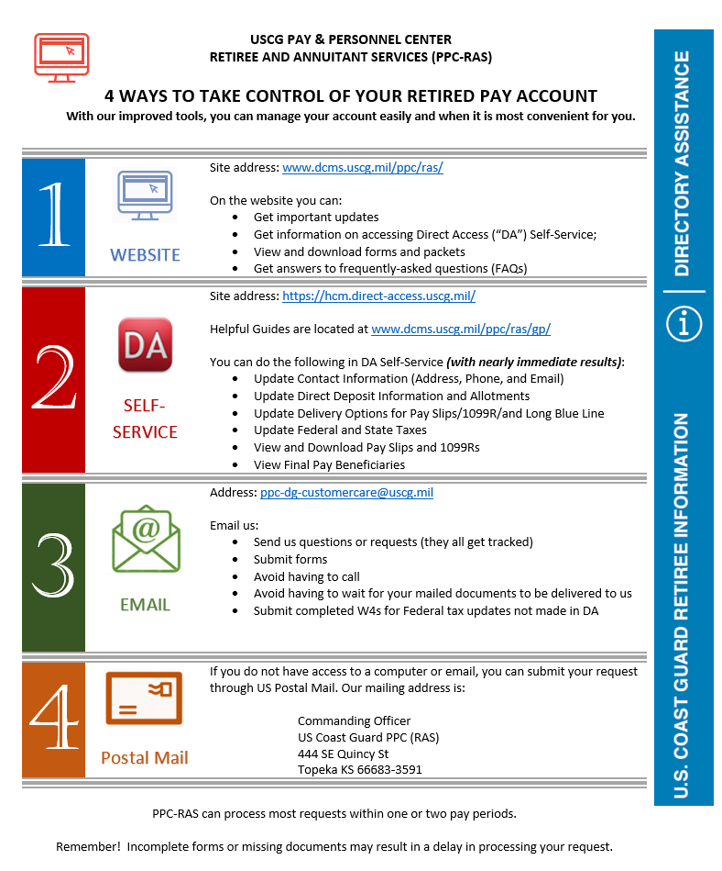
Self Service
30% of all requests coming to PPC can be performed through DA Self Service

Slide 14
Questions

